Slide 1
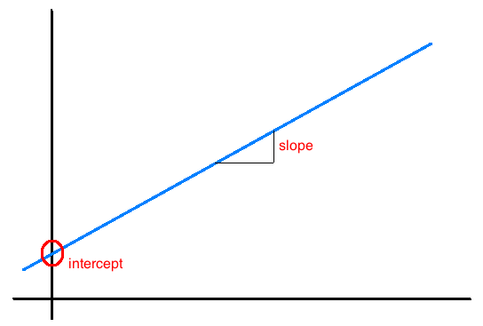
Interpretation of slope and intercept
Intercept: When x = 0, y is expected to equal the intercept.
Slope: For each unit in x, y is expected to increase / decrease on average by the slope.
Note: These statements are not causal, unless the study is a randomized controlled experiment.

Slide 2
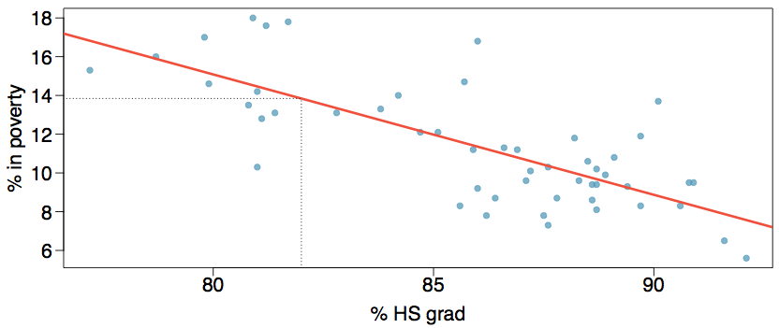
Prediction
Using the linear model to predict the value of the response variable for a given value of the explanatory variable is called prediction, simply by plugging in the value of x in the linear model equation.
There will be some uncertainty associated with the predicted value.

Slide 3
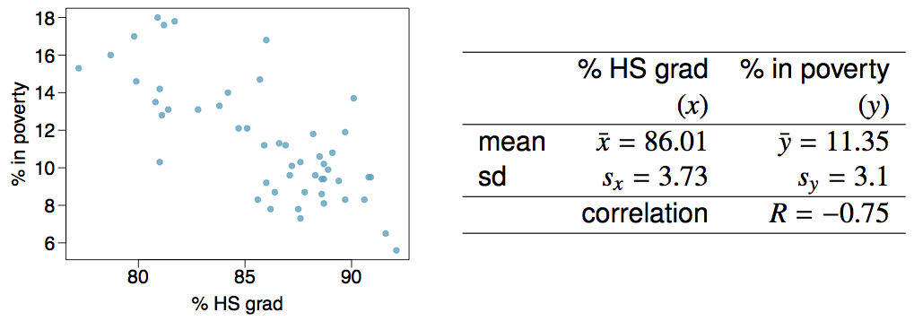
Given...

Slide 4
Which of the following is the correct interpretation of the intercept?
For each % point increase in HS graduate rate, % living in poverty is expected to increase on average by 64.68%.
For each % point decrease in HS graduate rate, % living in poverty is expected to increase on average by 64.68%.
Having no HS graduates leads to 64.68% of residents living below the poverty line.
States with no HS graduates are expected on average to have 64.68% of residents living below the poverty line.
In states with no HS graduates % living in poverty is expected to increase on average by 64.68%.

Slide 5
Which of the following is the correct interpretation of the intercept?
For each % point increase in HS graduate rate, % living in poverty is expected to increase on average by 64.68%.
For each % point decrease in HS graduate rate, % living in poverty is expected to increase on average by 64.68%.
Having no HS graduates leads to 64.68% of residents living below the poverty line.
States with no HS graduates are expected on average to have 64.68% of residents living below the poverty line.
In states with no HS graduates % living in poverty is expected to increase on average by 64.68%.

Slide 6
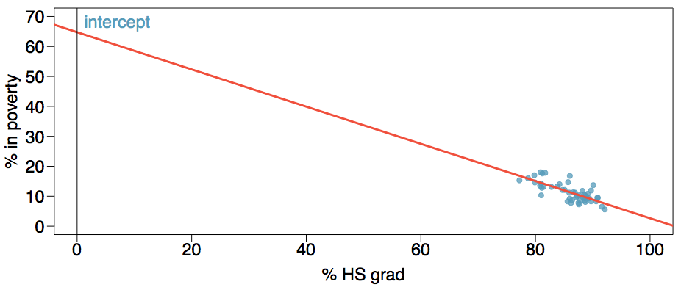
More on the intercept
Since there are no states in the dataset with no HS graduates, the intercept is of no interest, not very useful, and also not reliable since the predicted value of the intercept is so far from the bulk of the data.

Slide 7
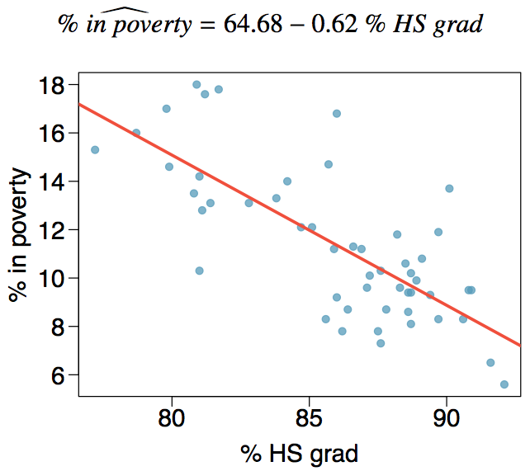
Regression line

Slide 8
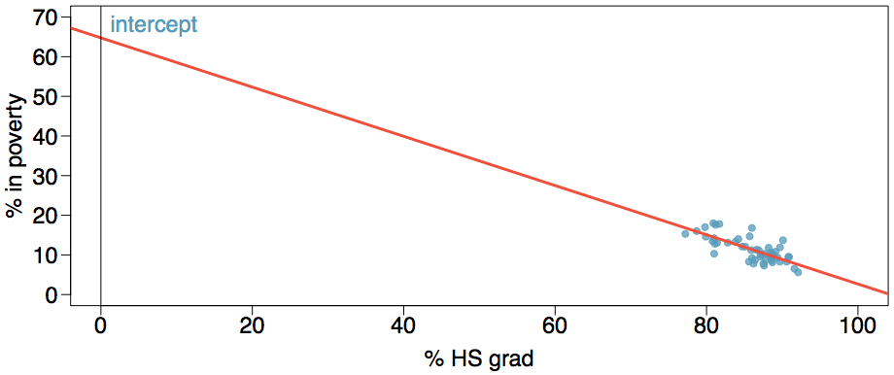
Extrapolation
Applying a model estimate to values outside of the realm of the original data is called extrapolation.
Sometimes the intercept might be an extrapolation.

Slide 9
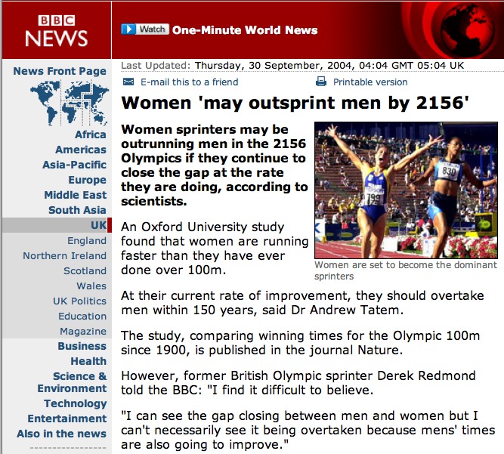
Examples of extrapolation

Slide 10
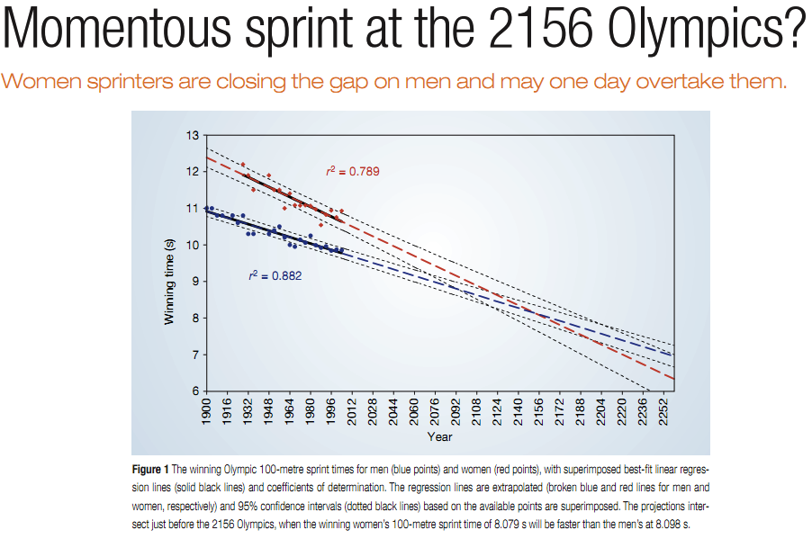
Examples of extrapolation

Slide 11
R²
The strength of the fit of a linear model is most commonly evaluated using R².

Slide 12
R²
The strength of the fit of a linear model is most commonly evaluated using R².
R² is calculated as the square of the correlation coefficient.

Slide 13
R²
The strength of the fit of a linear model is most commonly evaluated using R².
R² is calculated as the square of the correlation coefficient.
It tells us what percent of variability in the response variable is explained by the model.

Slide 14
R²
The strength of the fit of a linear model is most commonly evaluated using R².
R² is calculated as the square of the correlation coefficient.
It tells us what percent of variability in the response variable is explained by the model.
The remainder of the variability is explained by variables not included in the model or by inherent randomness in the data.

Slide 15
R²
The strength of the fit of a linear model is most commonly evaluated using R².
R² is calculated as the square of the correlation coefficient.
It tells us what percent of variability in the response variable is explained by the model.
The remainder of the variability is explained by variables not included in the model or by inherent randomness in the data.
For the model we've been working with, R² = -0.62² = 0.38.

Slide 16
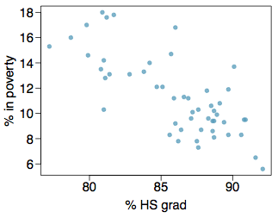
Interpretation of R²
Which of the below is the correct interpretation of R = -0.62, R² = 0.38?
38% of the variability in the % of HG graduates among the 51 states is explained by the model.
38% of the variability in the % of residents living in poverty among the 51 states is explained by the model.
38% of the time % HS graduates predict % living in poverty correctly.
62% of the variability in the % of residents living in poverty among the 51 states is explained by the model.

Slide 17
Interpretation of R²
Which of the below is the correct interpretation of R = -0.62, R² = 0.38?
38% of the variability in the % of HG graduates among the 51 states is explained by the model.
38% of the variability in the % of residents living in poverty among the 51 states is explained by the model.
38% of the time % HS graduates predict % living in poverty correctly.
62% of the variability in the % of residents living in poverty among the 51 states is explained by the model.

Slide 18
R²
What exactly is variability, both explained and unexplained?

Slide 19
R²
What exactly is variability, both explained and unexplained?
Total variability is the overall spread of the response variable. It is calculated by taking the sum of squares of the differences between each response and the mean response.

Slide 20
R²
What exactly is variability, both explained and unexplained?
Total variability is the overall spread of the response variable. It is calculated by taking the sum of squares of the differences between each response and the mean response.
Unexplained variability is the variability that is left over after fitting the model. It is calculated by taking the sum of squares of the differences between each response and the predicted response.

Slide 21
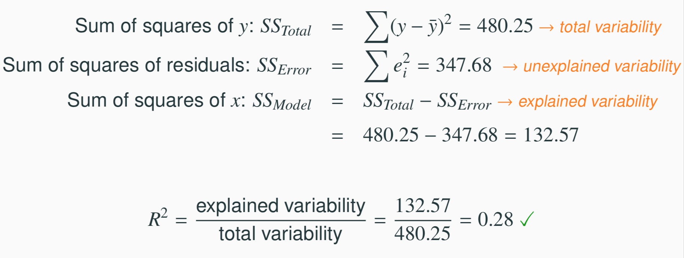
R²
What exactly is variability, both explained and unexplained?
Total variability is the overall spread of the response variable. It is calculated by taking the sum of squares of the differences between each response and the mean response.
Unexplained variability is the variability that is left over after fitting the model. It is calculated by taking the sum of squares of the differences between each response and the predicted response.

Slide 22
Types of outliers in linear regression

Slide 23
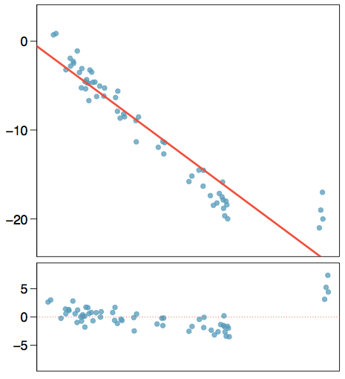
Types of outliers
How do outliers influence the least squares line in this plot?
To answer this question think of where the regression line would be with and without the outlier(s). Without the outliers the regression line would be steeper, and lie closer to the larger group of observations. With the outliers the line is pulled up and away from some of the observations in the larger group.

Slide 24
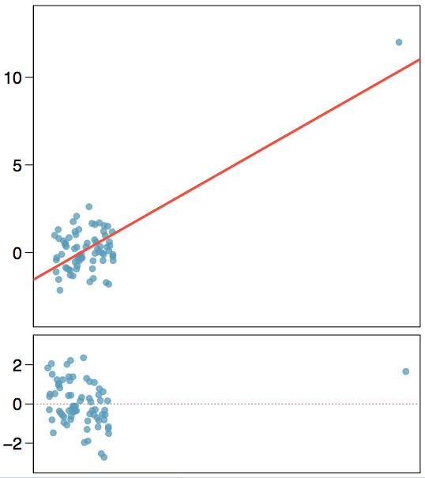
Types of outliers
How do outliers influence the least squares line in this plot?

Slide 25
Types of outliers
How do outliers influence the least squares line in this plot?
Without the outlier there is no evident relationship between x and y.

Slide 26
Some terminology
Outliers are points that lie away from the cloud of points.

Slide 27
Some terminology
Outliers are points that lie away from the cloud of points.
Outliers that lie horizontally away from the center of the cloud are called high leverage points.

Slide 28
Some terminology
Outliers are points that lie away from the cloud of points.
Outliers that lie horizontally away from the center of the cloud are called high leverage points.
High leverage points that actually influence the slope of the regression line are called influential points.

Slide 29
Some terminology
Outliers are points that lie away from the cloud of points.
Outliers that lie horizontally away from the center of the cloud are called high leverage points.
High leverage points that actually influence the slope of the regression line are called influential points.
In order to determine if a point is influential, visualize the regression line with and without the point. Does the slope of the line change considerably? If so, then the point is influential. If not, then it’s not an influential point.

Slide 30
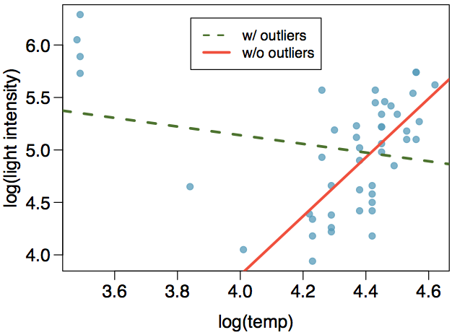
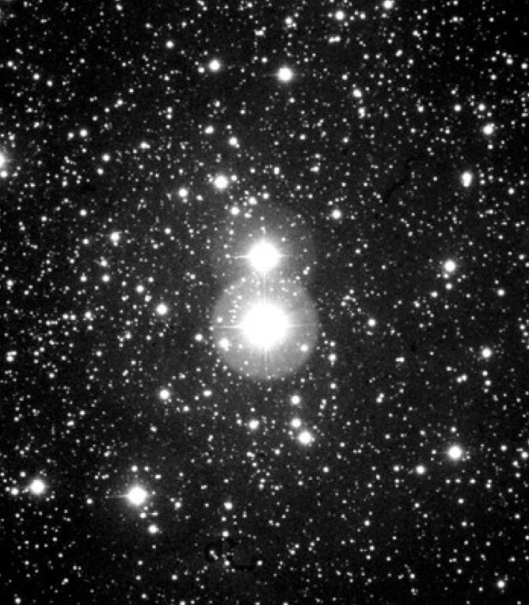
Influential points
Data are available on the log of the surface temperature and the log of the light intensity of 47 stars in the star cluster CYG OB1.

Slide 31
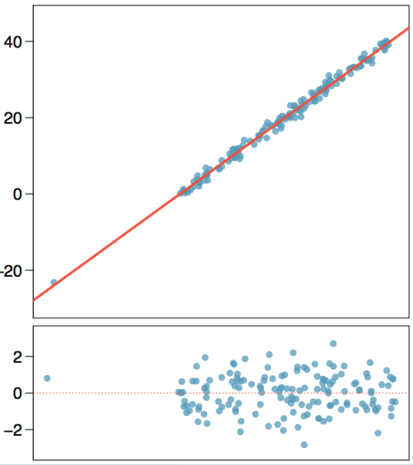
Types of outliers
Which of the below best describes the outlier?
influential
high leverage
none of the above
there are no outliers

Slide 32
Types of outliers
Which of the below best describes the outlier?
influential
high leverage
none of the above
there are no outliers

Slide 33
Recap
Which of following is true?
Influential points always change the intercept of the regression line.
Influential points always reduce R².
It is much more likely for a low leverage point to be influential, than a high leverage point.
When the data set includes an influential point, the relationship between the explanatory variable and the response variable is always nonlinear.
None of the above.

Slide 34
Recap
Which of following is true?
Influential points always change the intercept of the regression line.
Influential points always reduce R².
It is much more likely for a low leverage point to be influential, than a high leverage point.
When the data set includes an influential point, the relationship between the explanatory variable and the response variable is always nonlinear.
None of the above.

Slide 35
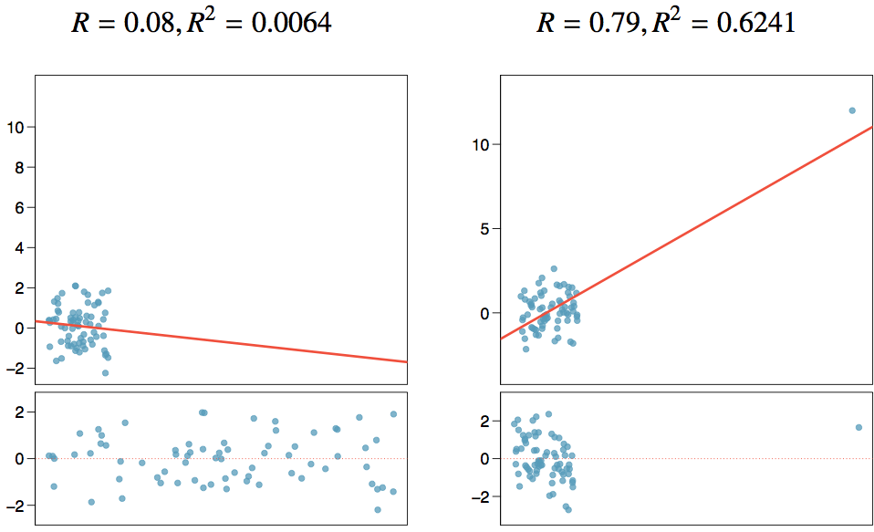
Recap (cont.)

Slide 36
Introduction to multiple regression

Slide 37
Multiple regression
Simple linear regression: Bivariate - two variables: y and x
Multiple linear regression: Multiple variables: y and x₁, x₂, · · ·
2

Slide 38
Multiple regression
Simple linear regression: Bivariate - two variables: y and x
Multiple linear regression: Multiple variables: y and x₁, x₂, · · ·
Motivating example: How can we model factor variables?
2

Slide 39

Poverty vs. region (east, west)
Explanatory variable: region, reference level: east
Intercept: The estimated average poverty percentage in eastern states is 11.17%
This is the value we get if we plug in 0 for the explanatory variable
Slope: The estimated average poverty percentage in western states is 0.38% higher than eastern states.
Then, the estimated average poverty percentage in western states is 11.17 + 0.38 = 11.55%.
This is the value we get if we plug in 1 for the explanatory variable
2

Slide 40
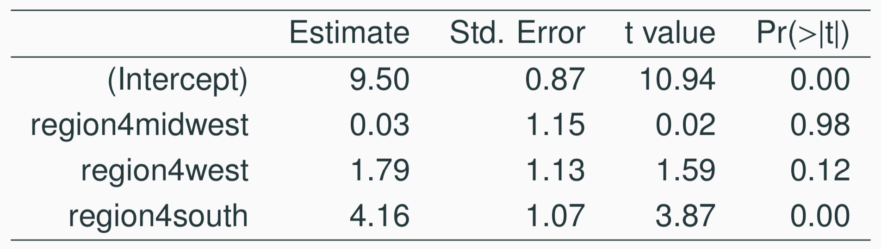
Poverty vs. region (northeast, midwest, west, south)
Which region (northeast, midwest, west, or south) is the reference level?
(a) northeast
(b) midwest
(c) west
(d) south
(e) cannot tell
2

Slide 41
Poverty vs. region (northeast, midwest, west, south)
Which region (northeast, midwest, west, or south) is the reference level?
(a) northeast
(b) midwest
(c) west
(d) south
(e) cannot tell
2

Slide 42
Poverty vs. region (northeast, midwest, west, south)
Which region (northeast, midwest, west, or south) has the lowest poverty percentage?
(a) northeast
(b) midwest
(c) west
(d) south
(e) cannot tell
2

Slide 43
Poverty vs. region (northeast, midwest, west, south)
Which region (northeast, midwest, west, or south) has the lowest poverty percentage?
(a) northeast
(b) midwest
(c) west
(d) south
(e) cannot tell
2

Slide 44

Weights of books
 | weight (g) | volume (cm³) | cover
1 | 800 | 885 | hc
2 | 950 | 1016 | hc
3 | 1050 | 1125 | hc
4 | 350 | 239 | hc
5 | 750 | 701 | hc
6 | 600 | 641 | hc
7 | 1075 | 1228 | hc
8 | 250 | 412 | pb
9 | 700 | 953 | pb
10 | 650 | 929 | pb
11 | 975 | 1492 | pb
12 | 350 | 419 | pb
13 | 950 | 1010 | pb
14 | 425 | 595 | pb
15 | 725 | 1034 | pb
l
h
w
3

Slide 45
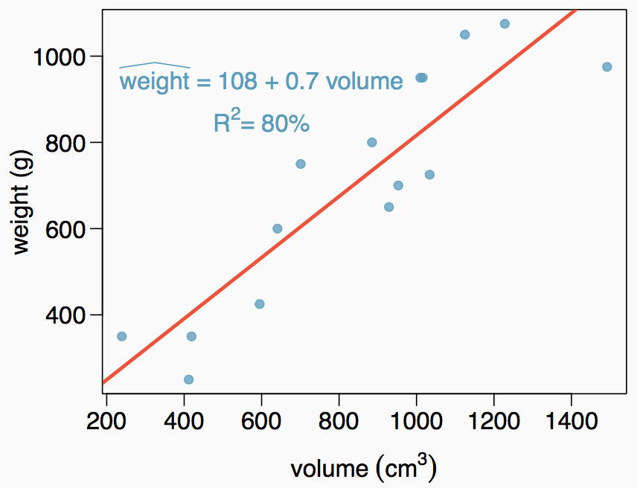
Weights of books (cont.)
The scatterplot shows the relationship between weights and volumes of books as well as the regression output. Which of the below is correct?
Weights of 80% of the books can be predicted accurately using this model.
Books that are 10 cm³ over average are expected to weigh 7g over average.
The correlation between weight and volume is R = 0.80² = 0.64.
The model underestimates the weight of the book with the highest volume.
4

Slide 46
Weights of books (cont.)
The scatterplot shows the relationship between weights and volumes of books as well as the regression output. Which of the below is correct?
Weights of 80% of the books can be predicted accurately using this model.
Books that are 10 cm³ over average are expected to weigh 7g over average.
The correlation between weight and volume is R = 0.80² = 0.64.
The model underestimates the weight of the book with the highest volume.
4

Slide 47
Modeling weights of books using volume
abbreviated output of lm()...
Coefficients:
Estimate Std. Error t value Pr(>|t|)
(Intercept) 107.67931 88.37758 1.218 0.245
Volume 0.70864 0.09746 7.271 6.26e-06
Residual standard error: 123.9 on 13 degrees of freedom Multiple R-squared: 0.8026,Adjusted R-squared: 0.7875
F-statistic: 52.87 on 1 and 13 DF, p-value: 6.262e-06

Slide 48
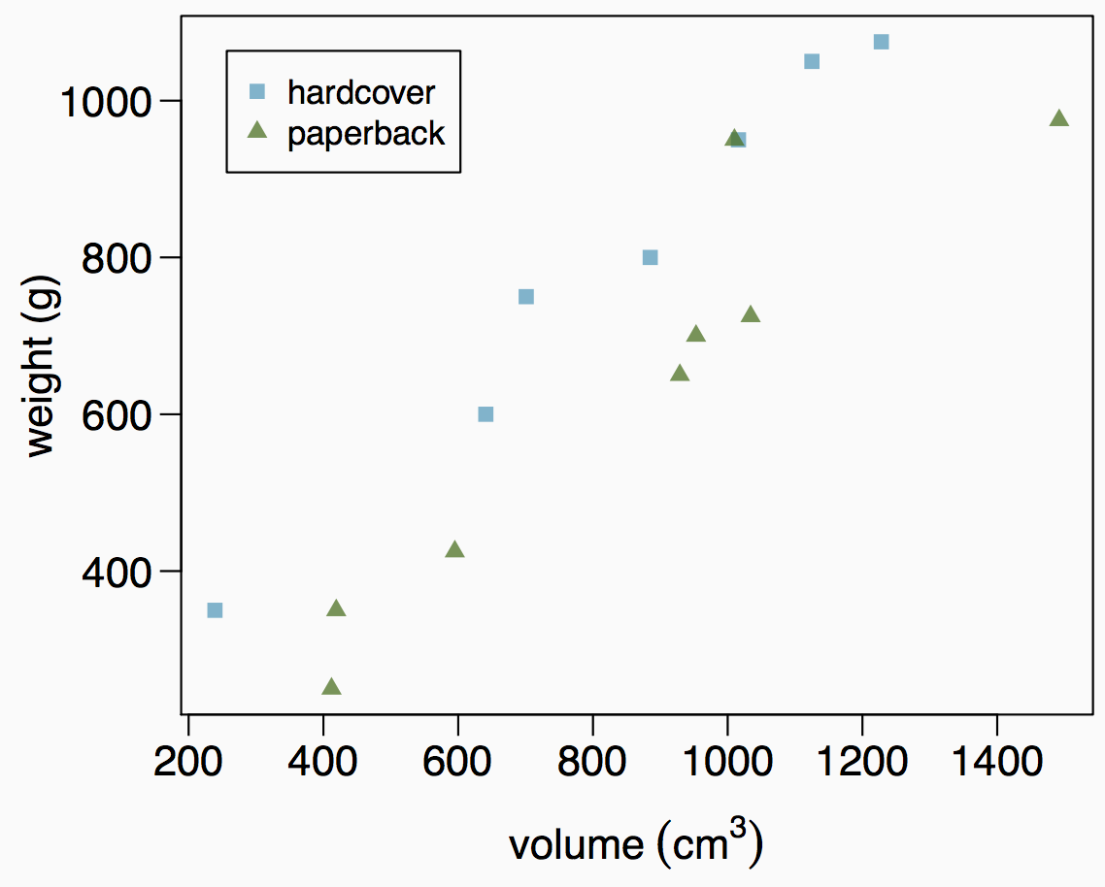
Weights of hardcover and paperback books
Can you identify a trend in the relationship between volume and weight of hardcover and paperback books?

Slide 49
Weights of hardcover and paperback books
Can you identify a trend in the relationship between volume and weight of hardcover and paperback books?
Paperbacks generally weigh less than hardcover books after controlling for the book's volume.

Slide 50
Modeling weights of books using volume and cover type
Coefficients:
 | Estimate | Std. Error | t value | Pr(>|t|)
(Intercept) | 197.96284 | 59.19274 | 3.344 | 0.005841 | **
volume | 0.71795 | 0.06153 | 11.669 | 6.6e-08 | ***
cover:pb | -184.04727 | 40.49420 | -4.545 | 0.000672 | ***
Residual standard error: 78.2 on 12 degrees of freedom Multiple R-squared: 0.9275,Adjusted R-squared: 0.9154 F-statistic: 76.73 on 2 and 12 DF, p-value: 1.455e-07

Slide 51
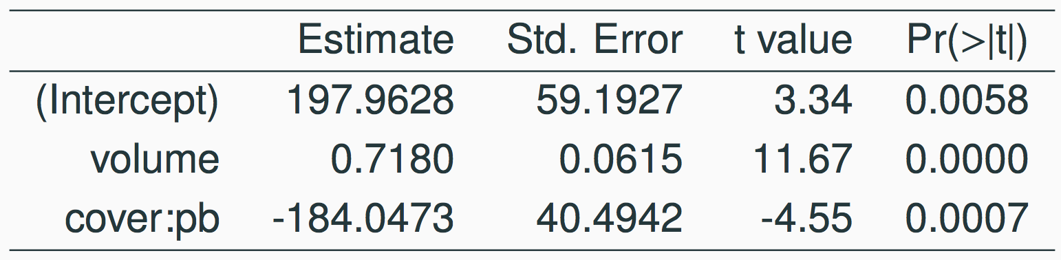
Determining the reference level
Based on the regression output below, which level of cover is the reference level? Note that pb: paperback.
paperback
hardcover
8

Slide 52
Determining the reference level
Based on the regression output below, which level of cover is the reference level? Note that pb: paperback.
paperback
hardcover
8

Slide 53
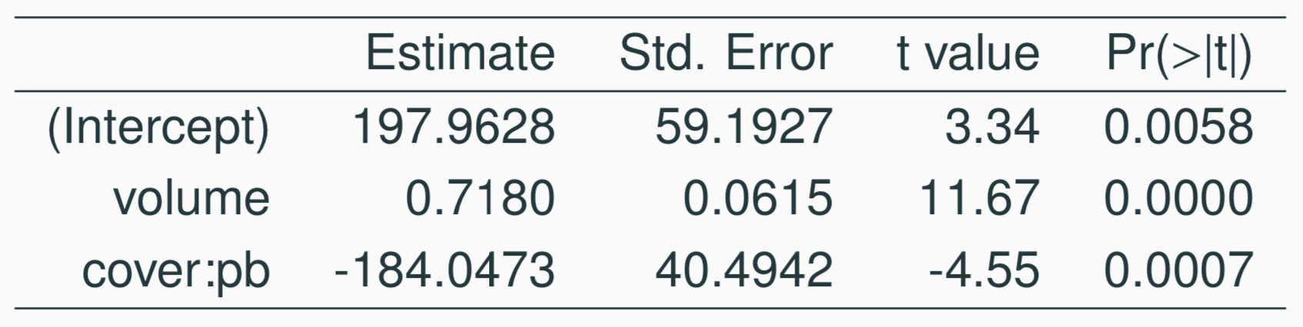
Determining the reference level
Which of the below correctly describes the roles of variables in this regression model?
response: weight, explanatory: volume, paperback cover
response: weight, explanatory: volume, hardcover cover
response: volume, explanatory: weight, cover type
response: weight, explanatory: volume, cover type
9

Slide 54
Determining the reference level
Which of the below correctly describes the roles of variables in this regression model?
response: weight, explanatory: volume, paperback cover
response: weight, explanatory: volume, hardcover cover
response: volume, explanatory: weight, cover type
response: weight, explanatory: volume, cover type
9

Slide 55
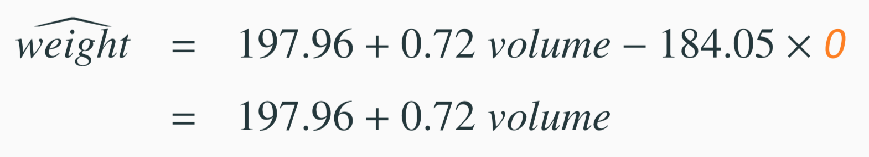
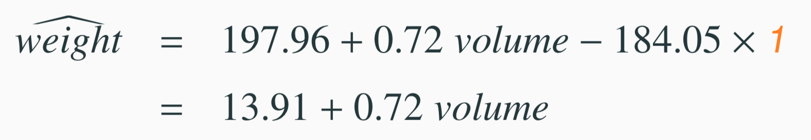
Linear Model
Estimate Std. Error t value Pr(>|t|)
(Intercept) | 197.96 | 59.19 | 3.34 | 0.01
volume | 0.72 | 0.06 | 11.67 | 0.00
cover:pb | -184.05 | 40.49 | -4.55 | 0.00
1. For hardcover books: plug in 0 for cover
2. For paperback books: plug in 1 for cover
12

Slide 56
Visualising the linear model
1000
hardcover paperback
800
600
400
weight (g)
200 400 600 800 1000 1200 1400
volume (cm³)

Slide 57
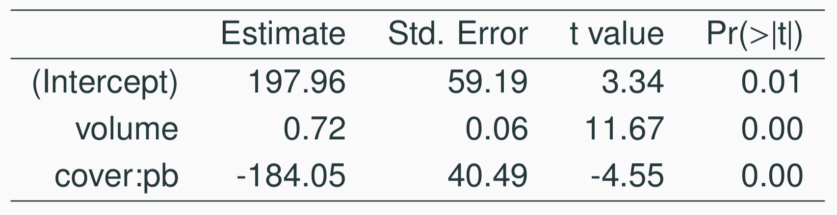
Linear model
Slope of volume: All else held constant, books that are 1 more cubic centimeter in volume tend to weigh about 0.72 grams more.
Slope of cover: All else held constant, the model predicts that paperback books weigh 184 grams lower than hardcover books.
Intercept: Hardcover books with no volume are expected on average to weigh 198 grams.
Obviously, the intercept does not make sense in context. It only serves to adjust the height of the line.
10

Slide 58
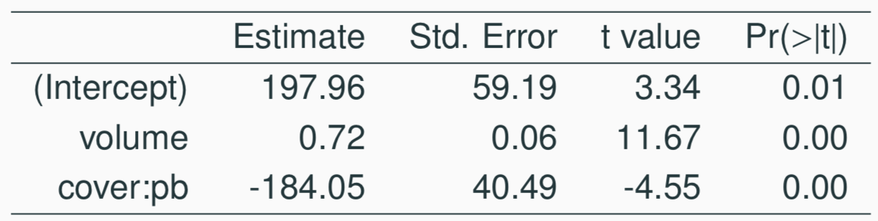
Prediction
Which of the following is the correct calculation for the predicted weight of a paperback book that is 600 cm³?
(a) 197.96 + 0.72 * 600 - 184.05 * 1
(b) 184.05 + 0.72 * 600 - 197.96 * 1
(c) 197.96 + 0.72 * 600 - 184.05 * 0
(d) 197.96 + 0.72 * 1 - 184.05 * 600
13

Slide 59
Prediction
Which of the following is the correct calculation for the predicted weight of a paperback book that is 600 cm³?
(a) 197.96 + 0.72 * 600 - 184.05 * 1
(b) 184.05 + 0.72 * 600 - 197.96 * 1
(c) 197.96 + 0.72 * 600 - 184.05 * 0
(d) 197.96 + 0.72 * 1 - 184.05 * 600
13

Slide 60
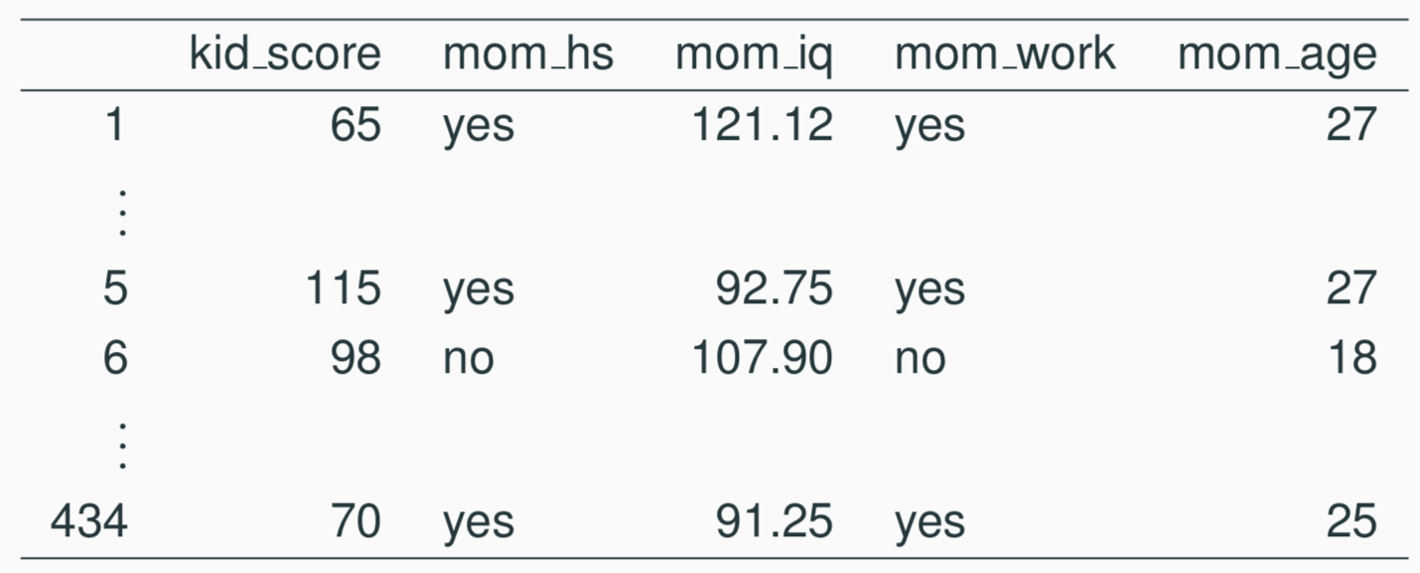
Another example: Modeling kid’s test scores
Predicting cognitive test scores of three- and four-year-old children using characteristics of their mothers. Data are from a survey of adult American women and their children - a subsample from the National Longitudinal Survey of Youth.
Gelman, Hill. Data Analysis Using Regression and Multilevel/Hierarchical Models. (2007) Cambridge University Press.

Slide 61
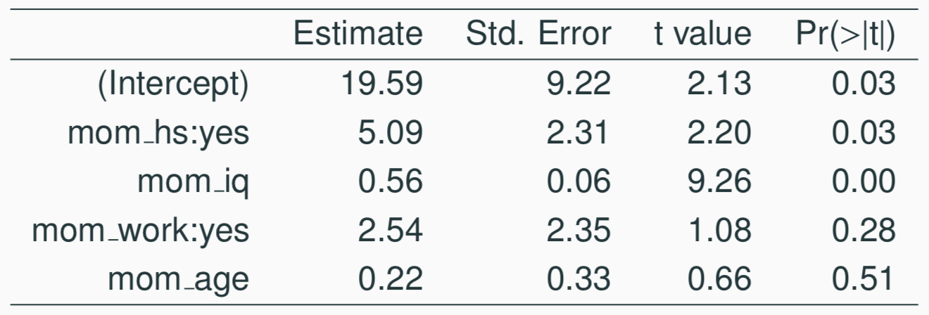
Interpreting the slope
What is the correct interpretation of the slope for mom’s IQ?
15

Slide 62
Interpreting the slope
What is the correct interpretation of the slope for mom’s IQ?
All else held constant, kids with mothers whose IQs are one point higher tend to score on average 0.56 points higher.
15

Slide 63
Interpreting the slope
What is the correct interpretation of the intercept?
15

Slide 64
Interpreting the slope
What is the correct interpretation of the intercept?
Kids whose moms haven’t gone to HS, worked during three years of the kid’s life, and have an IQ of 0 are expected on average to score 19.59.
Obviously, the intercept does not make any sense in this context.
15

Slide 65
Interpreting the slope
What is the correct interpretation of mom_work?
All else being equal, kids whose moms worked during the first three years of the kid’s life
(a) are estimated to score 2.54 points lower
(b) are estimated to score 2.54 points higher
than those whose moms did not work.
15

Slide 66
Interpreting the slope
What is the correct interpretation of mom_work?
All else being equal, kids whose moms worked during the first three years of the kid’s life
(a) are estimated to score 2.54 points lower
(b) are estimated to score 2.54 points higher
than those whose moms did not work.
15

Slide 67
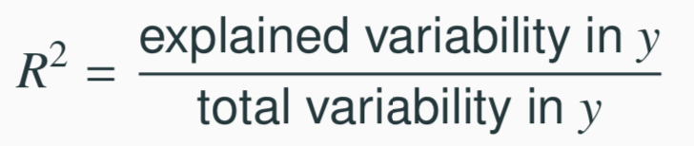
Another look at R²
R² can be calculated in three ways:
square the correlation coefficient of x and y (how we have been calculating it)
square the correlation coefficient of y and ŷ
based on definition:
Using ANOVA we can calculate the explained variability and total variability in y.
20

Slide 68
Why bother?
Why bother with another approach for calculating R² when we had a perfectly good way to calculate it as the correlation coefficient squared?
22

Slide 69
Why bother?
Why bother with another approach for calculating R² when we had a perfectly good way to calculate it as the correlation coefficient squared?
For single-predictor linear regression, having three ways to calculate the same value may seem like overkill.
However, in multiple linear regression, we can’t calculate R² as the square of the correlation between x and y because we have multiple xs.
22

Slide 70
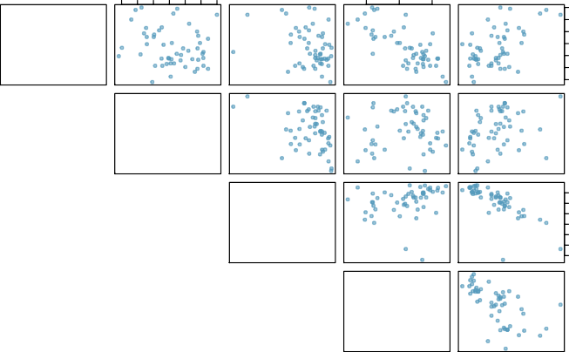
Revisit: Modeling poverty
40 50 60 70 80 90 100
80
85
90
poverty
6 8 10 14 18
100
80
−0.20
metro_res
60
40
−0.31
−0.34
white
30 50 70 90
90
0.018
0.24
85
−0.75
hs_grad
80
0.30
−0.61
0.53
−0.75
female_house
8 10 14 18
6 8 10 12 14 16 18
30 50 70 90
8 10 12 14 16 18

Slide 71
Why bother?
Why bother with another approach for calculating R² when we had a perfectly good way to calculate it as the correlation coefficient squared?
For single-predictor linear regression, having three ways to calculate the same value may seem like overkill.
However, in multiple linear regression, we can’t calculate R² as the square of the correlation between x and y because we have multiple xs.
And next we’ll learn another measure of explained variability, adjusted R², that requires the use of the third approach, ratio of explained and unexplained variability.
22

Slide 72
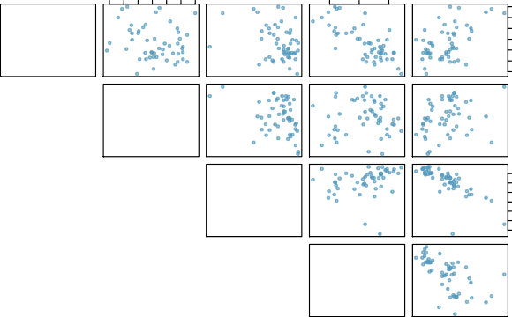
Does adding the variable white to the model add valuable information that wasn’t provided by female_house?
40 50 60 70 80 90 100
80
85
90
poverty
6 8 10 14 18
100
−0.20
80
metro_res
60
40
−0.31
−0.34
white
30 50 70 90
90
−0.75
0.018
0.24
85
hs_grad
80
0.30
−0.61
0.53
−0.75
30 50 70 90
female_house
8 10 14 18
6 8 10 12 14 16 18
8 10 12 14 16 18

Slide 73
Collinearity between explanatory variables (cont.)
Two predictor variables are said to be collinear when they are correlated, and this collinearity complicates model estimation.
Remember: Predictors are also called explanatory or independent variables. Ideally, they would be independent of each other.
26

Slide 74
Collinearity between explanatory variables (cont.)
Two predictor variables are said to be collinear when they are correlated, and this collinearity complicates model estimation. Remember: Predictors are also called explanatory or independent variables. Ideally, they would be independent of each other.
We don’t like adding predictors that are associated with each other to the model, because often times the addition of such variables brings nothing to the table. Instead, we prefer the simplest best model, i.e. parsimonious model.
While it’s impossible to avoid collinearity from arising in observational data, experiments are usually designed to prevent correlation among predictors.
26

Slide 75
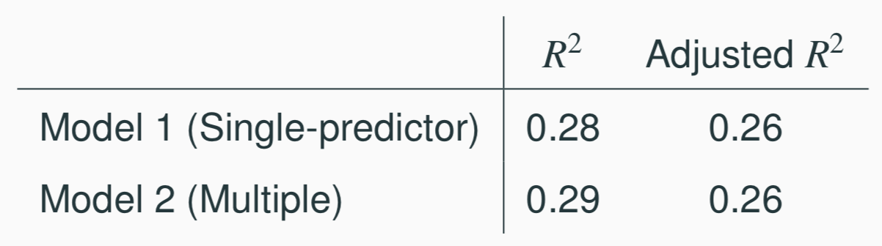
R² vs. adjusted R²
When any variable is added to the model R² increases.
But if the added variable doesn’t really provide any new information, or is completely unrelated, adjusted R² does not increase.
27

Slide 76
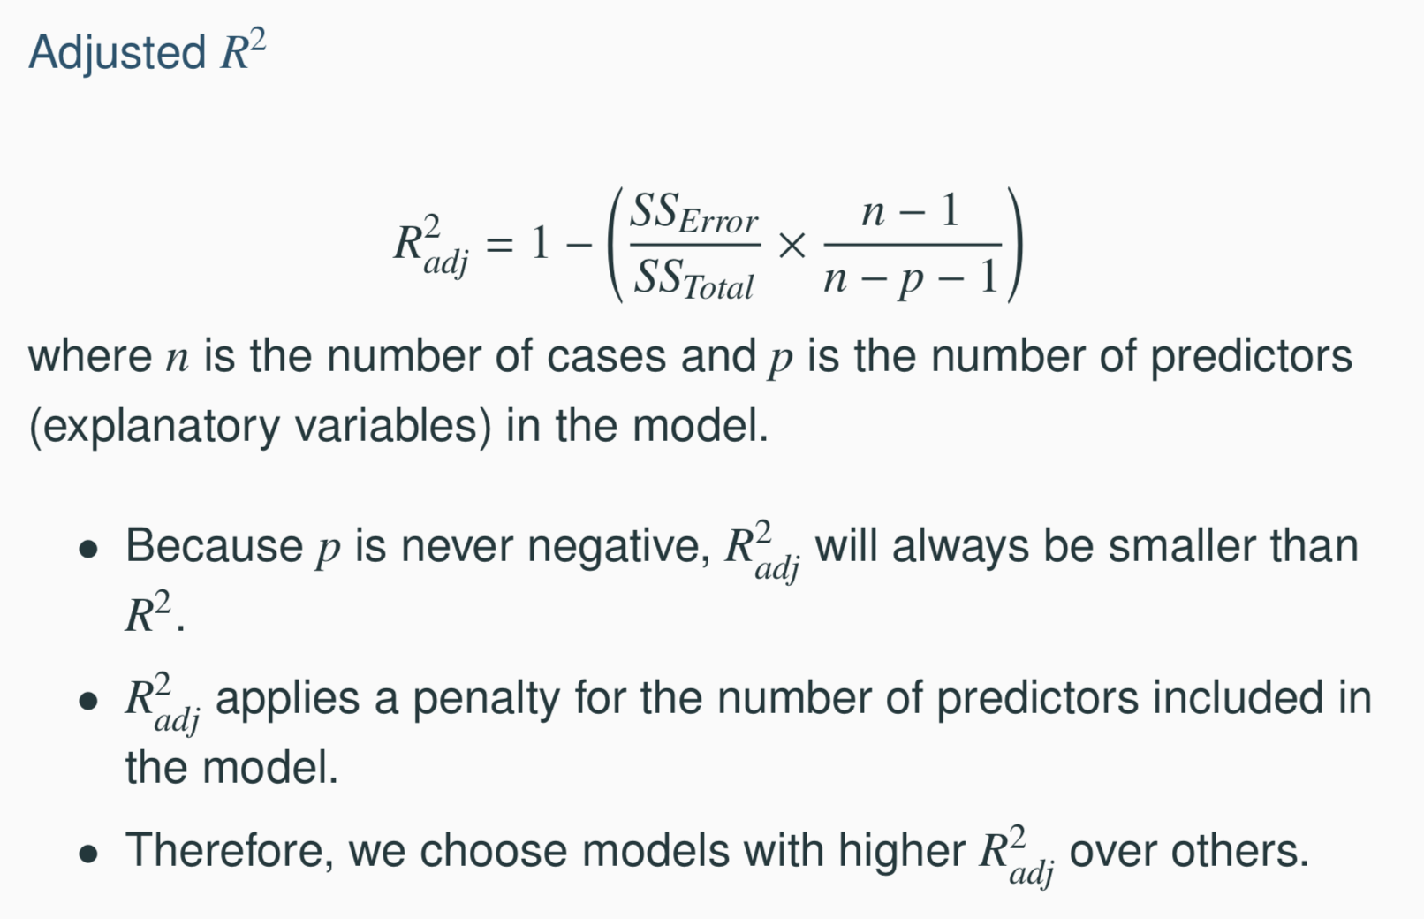
R² vs. adjusted R²
27

Slide 77
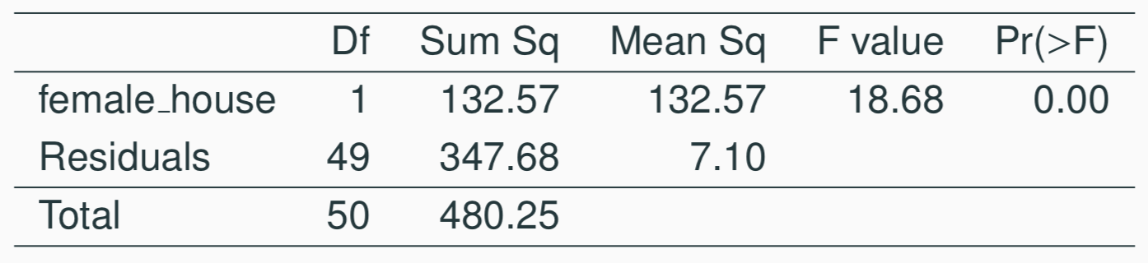
Sum of squares
21

Slide 78
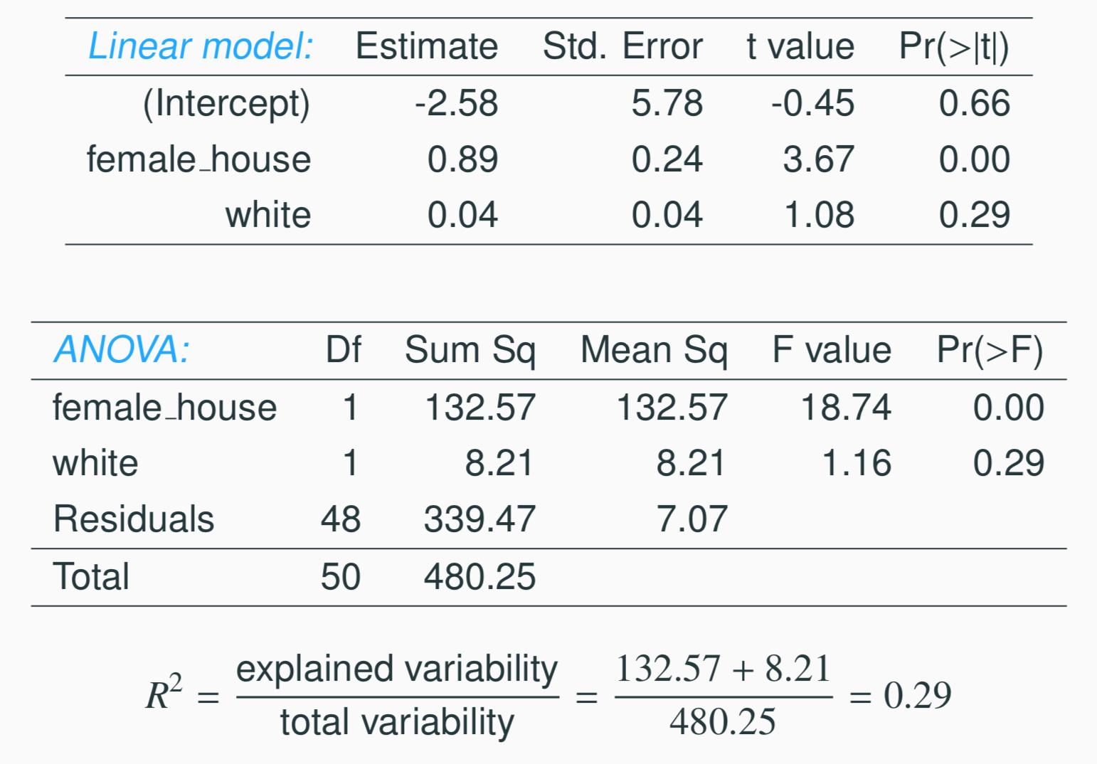
Predicting poverty using % female hh + % white
23

Slide 79
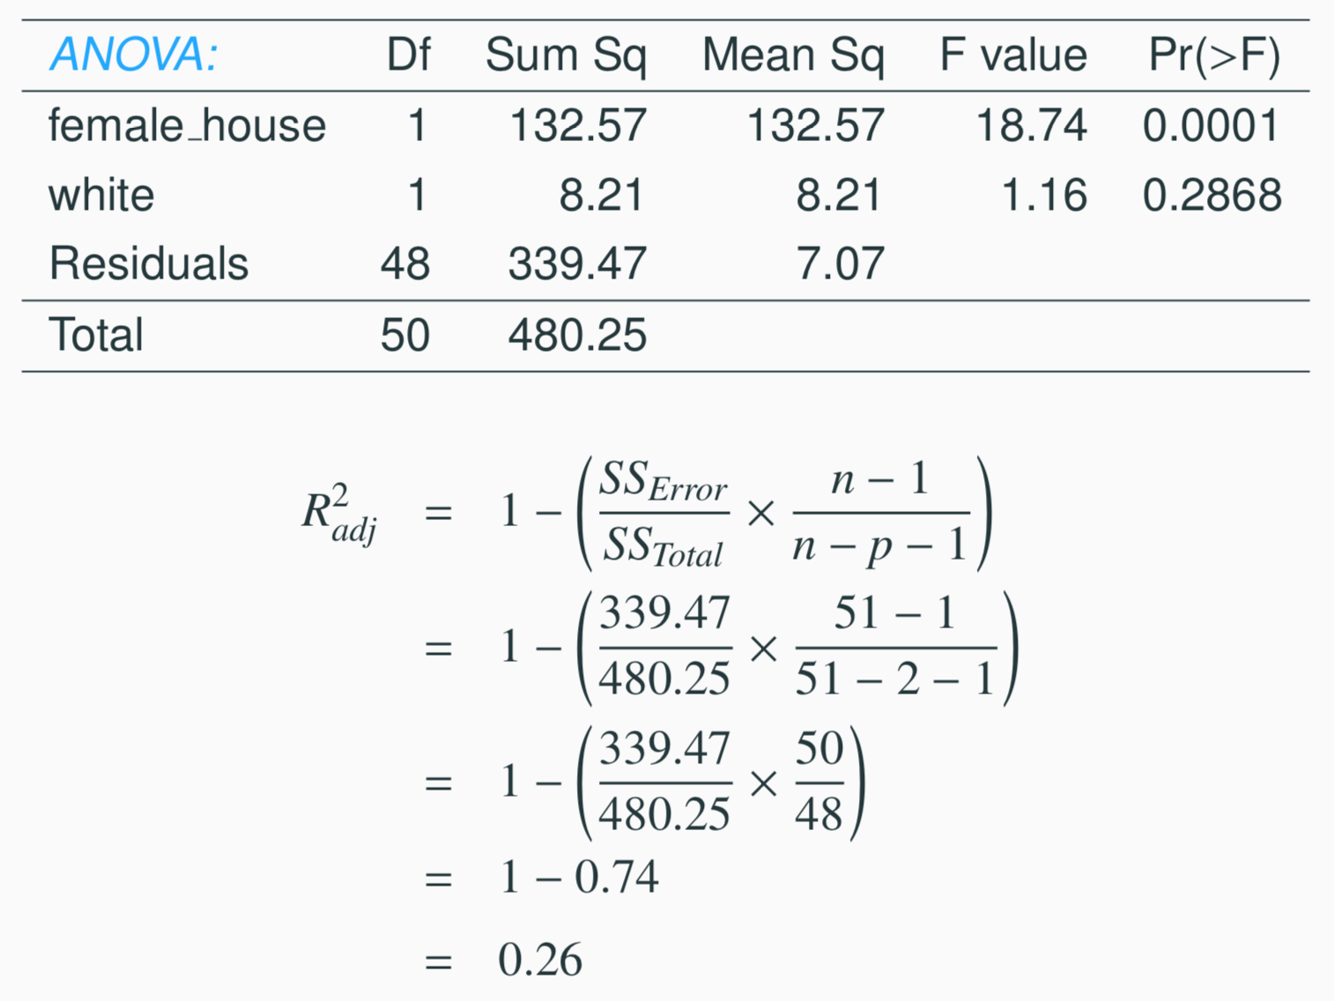
Calculate adjusted R²
27

Slide 80
Model selection

Slide 81
Beauty in the classroom
Data: Student evaluations of instructors’ beauty and teaching quality for 463 courses at the University of Texas.
Evaluations conducted at the end of semester, and the beauty judgements were made later, by six students who had not attended the classes and were not aware of the course evaluations (2 upper level females, 2 upper level males, one lower level female, one lower level male).
Hamermesh & Parker. (2004)“Beauty in the classroom: instructorsO˜ pulchritude and putative pedagogical productivityO´
Economics Education Review.

Slide 82
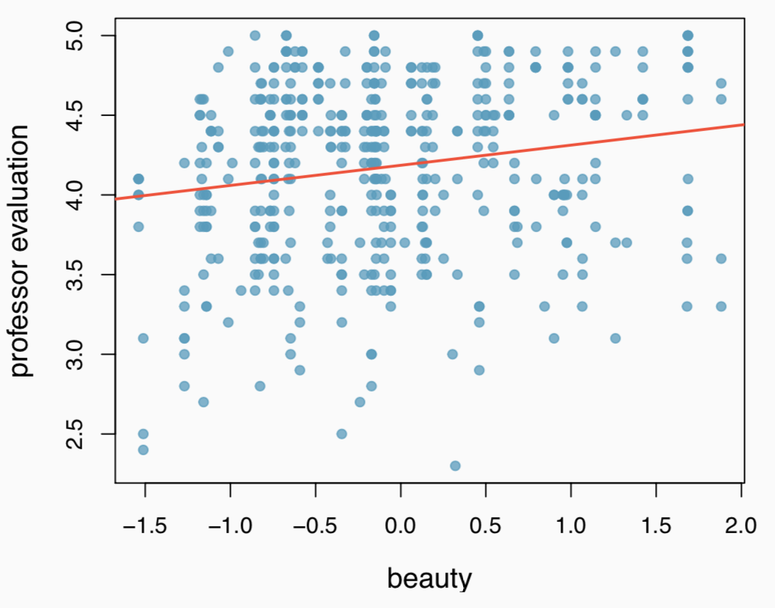
Professor rating vs. beauty
Professor evaluation score (higher score means better) vs. beauty score (a score of 0 means average, negative score means below average, and a positive score above average):
27

Slide 83
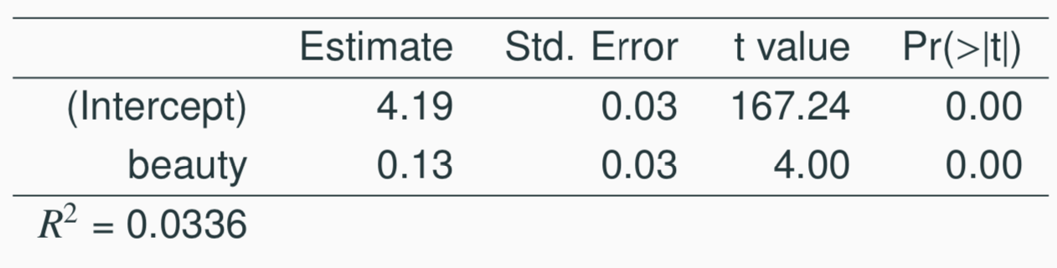
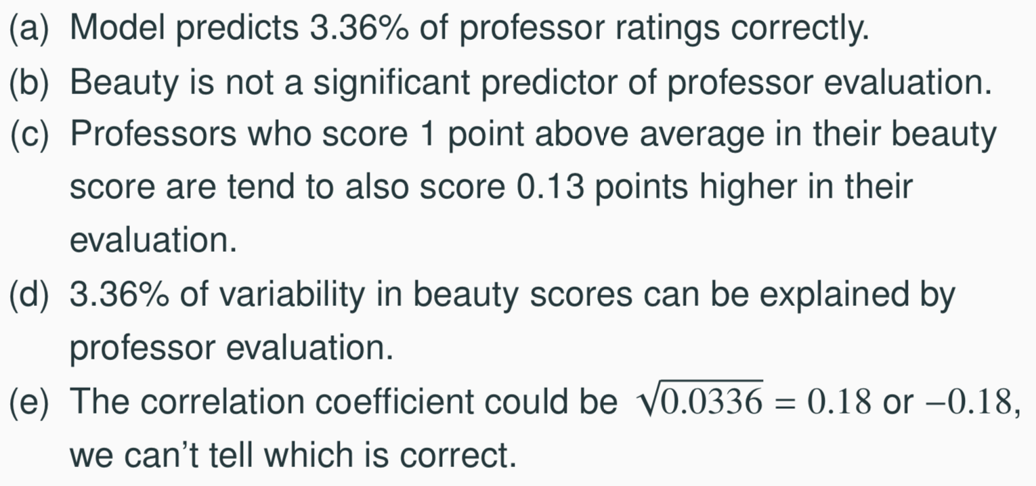
Which of the below is correct based on the model output?
33

Slide 84
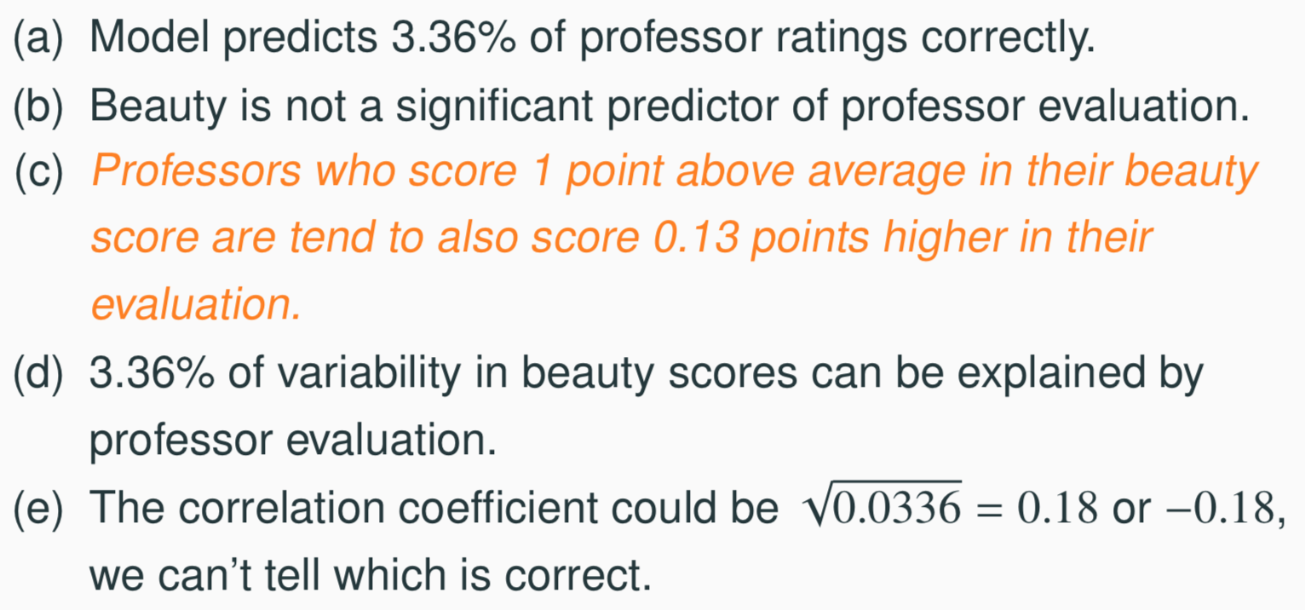
Which of the below is correct based on the model output?
33

Slide 85
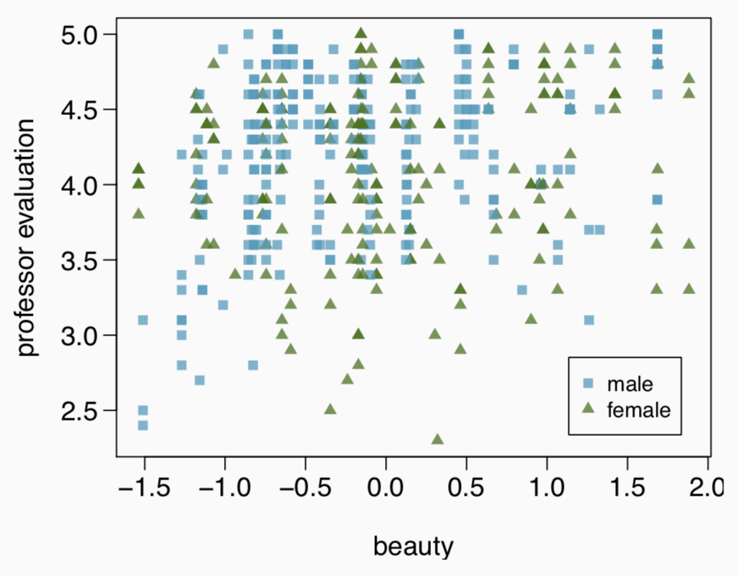
Exploratory analysis
Any interesting features?
For a given beauty score, are male professors evaluated higher, lower, or about the same as female professors?
27

Slide 86
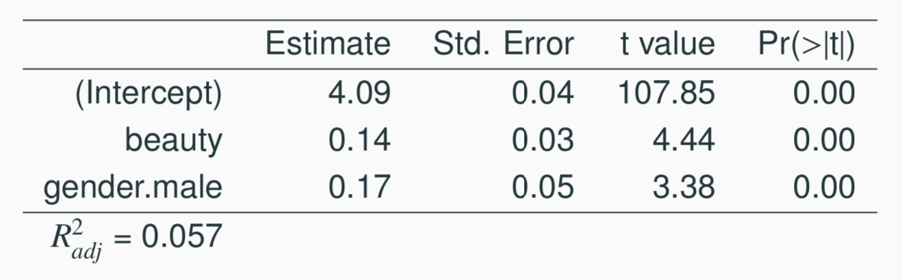
Professor rating vs. beauty + gender
For a given beauty score, are male professors evaluated higher, lower, or about the same as female professors?
(a) higher
(b) lower
(c) about the same
27

Slide 87
Professor rating vs. beauty + gender
For a given beauty score, are male professors evaluated higher, lower, or about the same as female professors?
(a) higher → Beauty held constant, male professors are rated
0.17 points higher on average than female professors.
(b) lower
(c) about the same
27

Slide 88
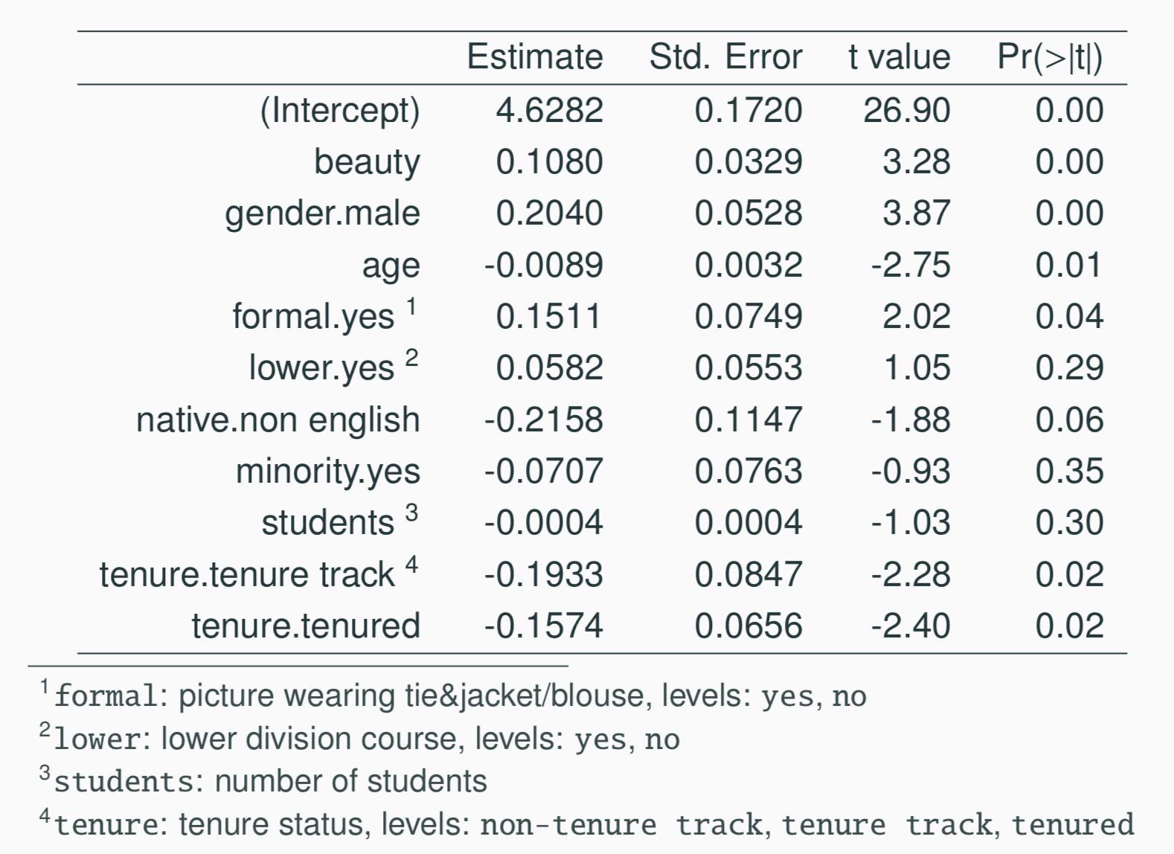
Full Model
27

Slide 89
Model selection strategies
Based on what we’ve learned so far, what are some ways you can think of that can be used to determine which variables to keep in the model and which to leave out?

Slide 90
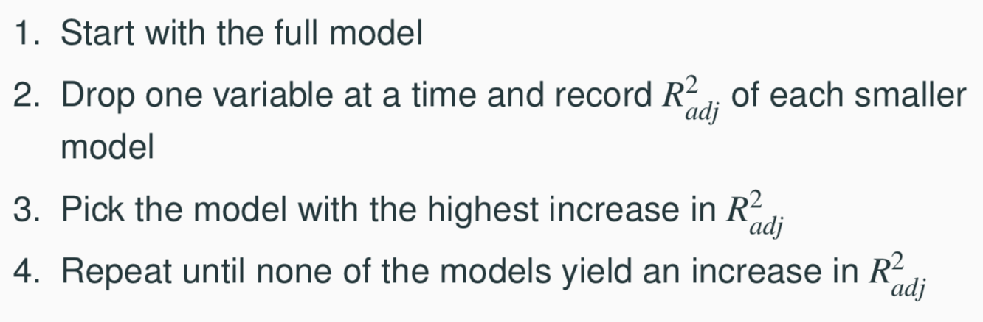
Backward-elimination
27

Slide 91
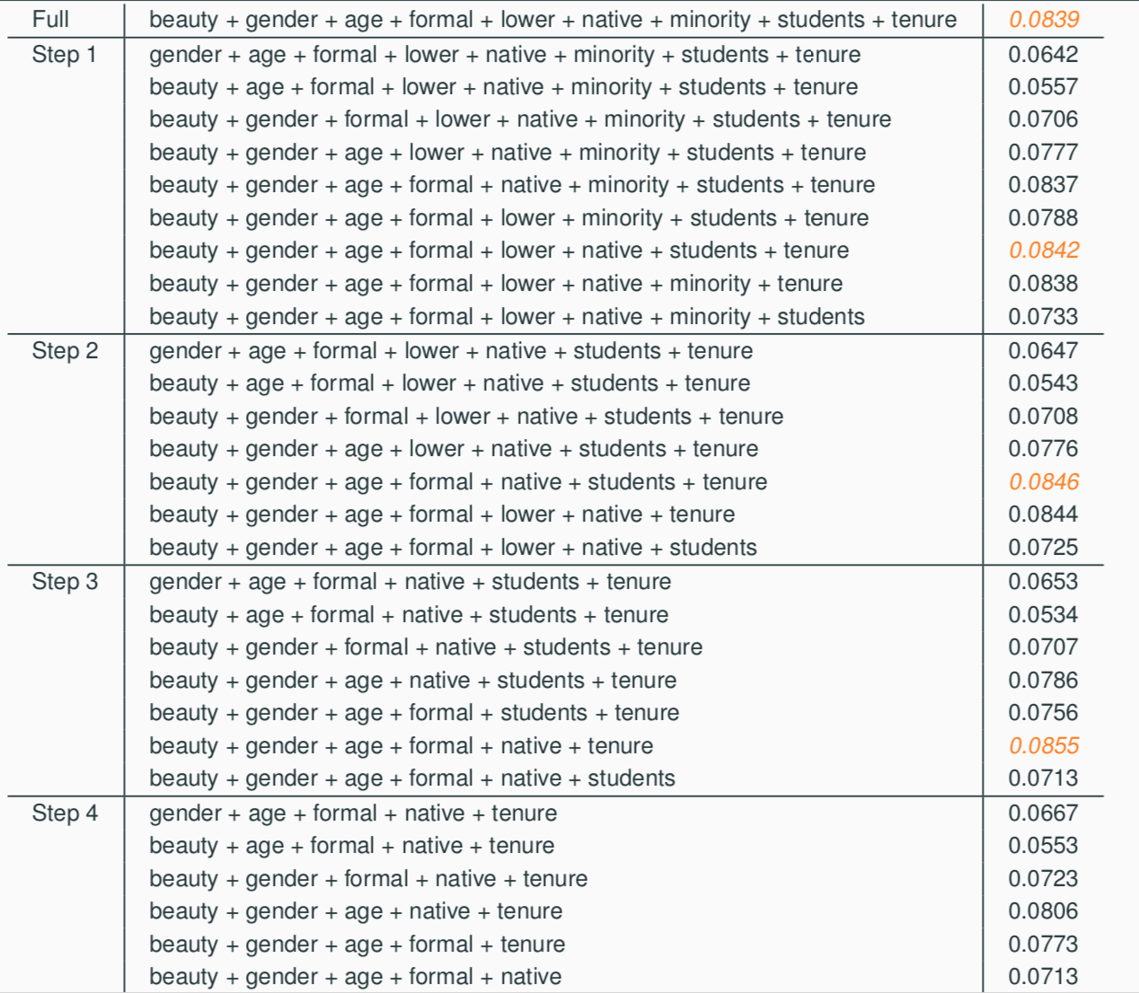
Backward-elimination
27

Slide 92
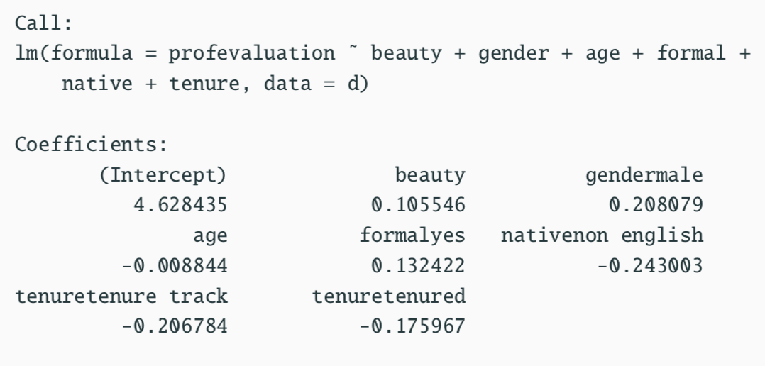
step function in R
The step function in R does a similar backward elimination process, however it uses a different metric called AIC (Akaike Information Criterion) instead of adjusted R² to do the model selection.
Best model: beauty + gender + age + formal + native + tenure
27

Slide 93
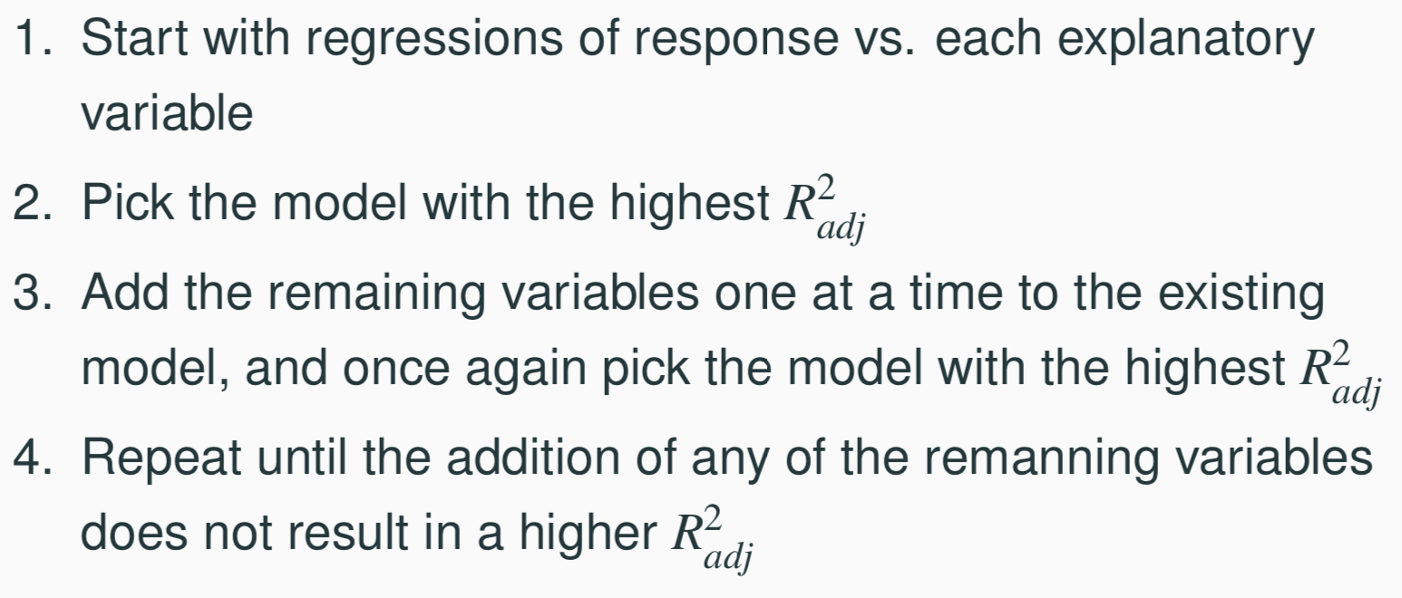
Forward-selection
27

